Slide 1
ANALYZING RESPONDERS IN A BANK TELEMARKETING DATASET
Presented By:
Jinesh Kachhara (10414040)
Ankita Tawde (10414524)
Dishant Gala (10416085)
Malay Shah (10413604)

Slide 2
INTRODUCTION
A Portuguese Bank has provided 42,000 rows of customer data out of which 4665 customers were converted in subscribing to term deposit.
From these 4665 customer data we need to identify a pattern that would help us determine significant group of customers that could be targeted.
The data is related with direct marketing campaigns of a Portuguese banking institution where these marketing campaigns were based on phone calls. Often, more than one contact to the same client was required in order to sell the product(bank term deposit)
This would help the bank in saving the cost required for marketing and would help in attaining more customers in less time.
Jinesh Kachhara

Slide 3
DATA SET
Sr No | Variable | Type | Description
1 | Age | Numeric | Age of the person speaking on phone
2 | Job | Categorical | Type of Job ('admin.','blue-collar','entrepreneur','housemaid','management','retired','self-employed','services','student','technician','unemployed','unknown')
3 | Marital | Categorical | Marital status ('divorced','married','single','unknown')
4 | Education | Categorical | Education completed (‘Primary’, ‘Secondary’, ‘Tertiary’, ‘unknown’)
5 | Default | Categorical | Has credit in default? (‘yes’,’no’,’unknown’)
6 | Balance | Numeric | How much balance customer has?
7 | Housing | Categorical | Has housing loan? (‘yes’,’no’,’unknown’)
8 | Loan | Categorical | Has personal loan? (‘yes’,’no’,’unknown’)
9 | Contact | Categorical | contact communication type ('cellular','telephone')
Jinesh Kachhara

Slide 4
DATASET
Sr No | Variable | Type | Description
10 | Day | Numeric | Date on which the customer was contacted
11 | Month | Categorical | Month in which the customer was contacted
12 | Duration | Numeric | Duration in seconds. Important note: this attribute highly affects the output target (e.g., if duration=0 then y='no')
13 | Campaign | Numeric | Number of contacts performed during a particular campaign and for particular client
14 | pdays | Numeric | Number of days that passed by after the client was last contacted from a previous campaign
15 | Previous | Numeric | Number of contacts performed before a particular campaign and for a particular client
16 | poutcome | Categorical | Outcome of the previous marketing campaign ('failure','nonexistent','success')
17 | y | Binary | Desired target. has the client subscribed a term deposit? ('yes','no')
Jinesh Kachhara

Slide 5
PROCESS
The following steps are performed:
Data Cleaning
Data Preparation
Modeling
Gains Chart
Ankita Tawde

Slide 6
1. DATA CLEANING
Data Cleaning is a process of detecting and correcting incorrect, incomplete and inaccurate data from the database.
Missing Value eliminated
Ankita Tawde

Slide 7
2. DATA PREPARATION
Data preparation means manipulation of data into a form suitable for further analysis and processing. It is a process that involves many different tasks and which cannot be fully automated.
Age -> create a basket (i.e 18-25, 26-35, 36-45, 46-55, etc.)
Duration -> create a basket (i.e 0-2, 3-4, 5-6, 7-8, etc.)
Campaign -> create a basket (i.e 1,2,3,4+)
Previous -> create a basket (i.e 0,1,2+)
Ankita Tawde

Slide 8
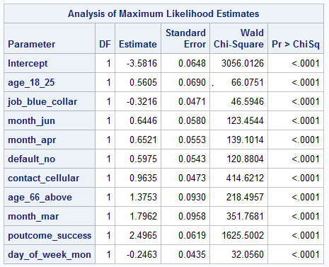
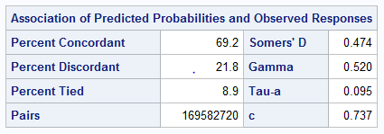
3. LOGISTIC REGRESSION
Dishant Gala

Slide 9
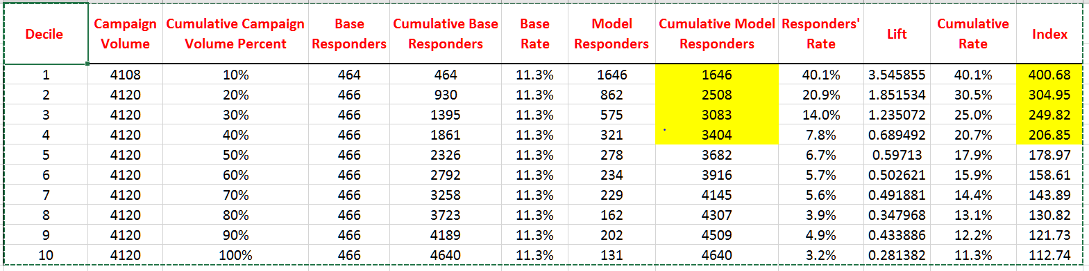
4. GAINS CHART
Malay Shah

Slide 10
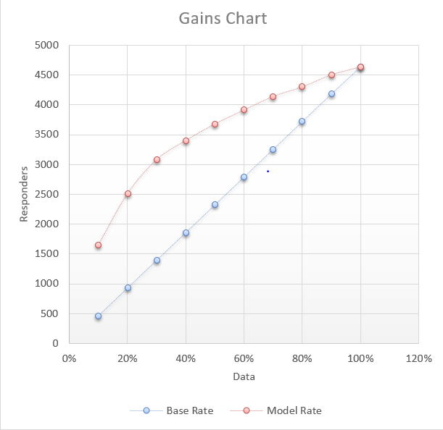
Malay Shah

Slide 11
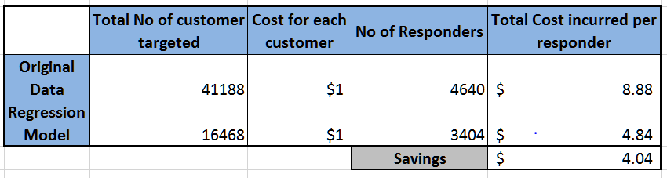
RESULTS
The bank incurred a cost of $8.88 per responder before running the model. After running our model we were able to decrease this cost to $4.84, in turn helping the bank to make a profit of $4.04 per responder.
Malay Shah

Slide 12
CONCLUSION
The company should focus on the following demographics for successful implementation of their campaign.
Summer period (March-June)
Age (18 to 25 and above 65)
No loan default
Contacted on cell phone
Responders of previous campaign
The following demographics shouldn’t be considered:
Individuals with blue collar job
First day of the week i.e. Monday
Malay Shah

